Slide 1
Online Examination System
Prepared By : Aswhani Banerje, Neha Shaw, Ankita Kairy
Project Guide : Debashree Bhattcharya

Slide 2
Introduction
The Online Exam System is a comprehensive and user-friendly platform designed to facilitate the administration, management, and conduct of exams in a virtual environment. This innovative project aims to replace traditional paper-based examinations with a modern and efficient online approach, providing a seamless experience for students, instructors, and administrators alike.
The advancement of technology and the widespread availability of the internet have significantly transformed the education sector, offering numerous opportunities for enhanced learning experiences. Online exams offer several advantages, such as increased accessibility, reduced paperwork, real-time result processing, and improved security

Slide 3
Idea Generation
Taking a survey from the teachers of a institution have helped us gather the information about our project which includes:
Asking about the idea: Getting a clear knowledge about the idea of making a real time online examination system to improve the performance of a student.
Planning: Taking necessary steps to create effective learning based online system
Discussing: Discussing about the ideas among ourselves and finding ways to add more / make improvement

Slide 4
OBJECTIVE
The primary objective of the Online Exam System project is to create an intuitive, secure, and scalable platform that streamlines the entire examination process. The system aims to offer the following benefits:
Accessibility: Students can take exams from any location with internet access, eliminating the need for physical presence in examination centers.
Flexibility: The platform allows students to take exams at their convenience, within predetermined time frames, accommodating diverse schedules.
Instant Result Processing: The system will automatically evaluate answers and generate results in real-time, minimizing the time taken to declare the exam outcomes.
Enhanced Security: Implementing robust security measures will ensure the integrity of the examination process, preventing cheating and malpractices.
Comprehensive Reporting: The system will provide detailed reports and analytics, enabling administrators and educators to assess individual and overall performance.

Slide 5
Features
The Online Exam System will incorporate a range of essential features to facilitate seamless exam management:
User Registration: Students and instructors will be required to register and create personalized accounts to access the platform.
Exam Creation: Instructors can create and customize exams, including setting question types, time limits, and other parameters.
Question Bank: A repository of questions categorized by subjects and difficulty levels will be available to instructors for exam creation.
Exam Scheduling: Administrators can schedule exams, notifying registered students about the upcoming tests and relevant details.
Exam Taking: Students can log in during the designated exam time and take the test under a controlled environment.
Real-time Assessment: The system will evaluate answers automatically, providing instant results to students upon exam completion.
Security Measures: The platform will employ encryption, IP tracking, and anti-cheating techniques to ensure the integrity of the exams.
Analytics and Reporting: Comprehensive reports will be generated for both students and instructors, offering insights into performance and areas of improvement.

Slide 6
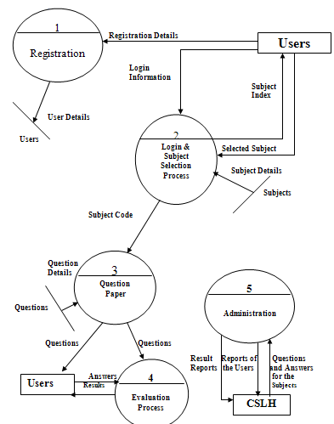
DFD Diagram

Slide 7
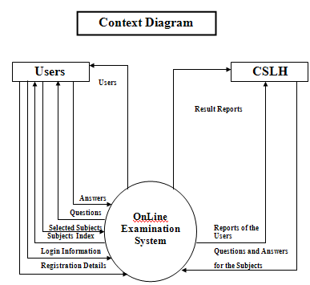
Context diagram

Slide 8
System Requirements Specifications
Hardware:
Client side
Intel 586 and above/Alpha
16 MB RAM
Cache Memory 256 KB
Network Interface card
Server side
Pentium II Machine 233 MHz
64 MB RAM
Network Interface cards-TCP/IP

Slide 9
Sofware :
Client side
Operating System Independent
Netscape Communicator 4.6
Internet and Intranet connection tools
MS Access ODBC Driver
Server side
Operating System Independent
Web Server-Internet Information Server(IIS)
MS-Access

Slide 10
SYSTEM SCOPE
The information system group has been charged with the responsibility to develop the new personnel information system to meet the requirements listed above. This responsibility will entail a major overhead of the present system.

Slide 11
STUDY FACTS TO BE RECOLLECTED
Organizations chart and job description to study.
Determine decision points.
Present information flow.
Analysis of present technology.
Analysis of kinds and duration of information.
Determination of end user information needs.
Analysis of ways to serve organization better through the information system.

Slide 12
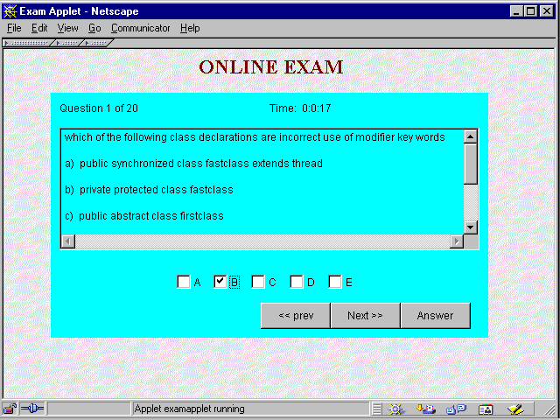
Screen Shots

Slide 13
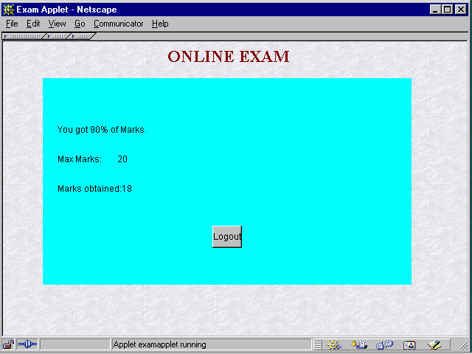

Slide 14
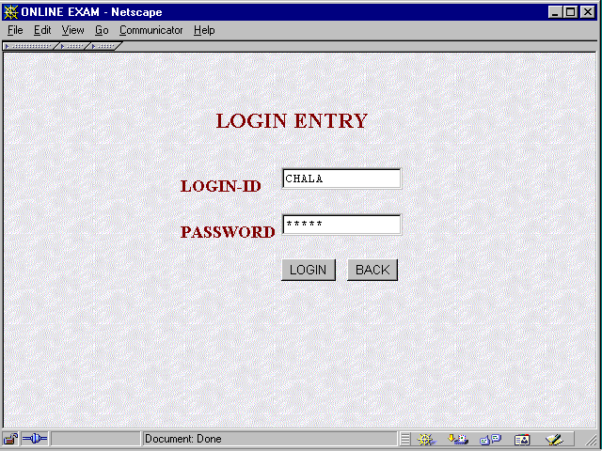

Slide 15
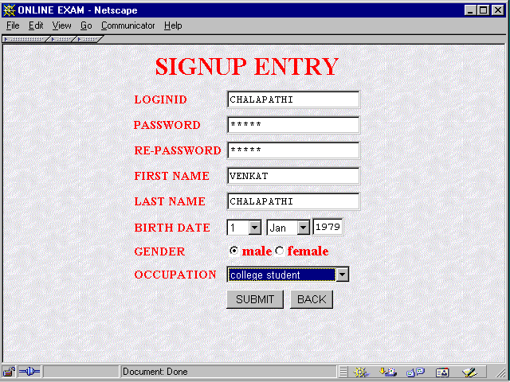

Slide 16
Download full project source code link. https://github.com/abamie/ExamSystem.git

Slide 17
Conclusion
The Online Exam System project aims to revolutionize the traditional examination process by offering a secure, accessible, and efficient online platform. Through its user-friendly interface, advanced features, and robust security measures, the system seeks to enhance the overall examination experience for all stakeholders involved. By embracing technology and adaptability, the project strives to contribute to the advancement of modern education and evaluation practices.

